Slide 1
PHP & MySQL
SQL tutorial: http://www.w3schools.com/sql/default.asp

Slide 2
Outline
Why databases?
What is a database anyway?
History of databases
Important DMBS features
Relational data model
Why its great
What it looks like (SQL)

Slide 3
Why Databases?
In the early days, database applications were built on top of file systems.
Drawbacks of using file systems to store data:
Data redundancy and inconsistency
Multiple file formations, duplication of information in different files
Difficulty in accessing data
Need to write a new program to carry out each new task
Data Isolation – multiple files and formats
Integrity problems
Enforcing integrity constraints
Adding / changing existing constraints

Slide 4
Why Databases?
Drawbacks of using file systems (cont.)
Atomicity of updates
Failures may leave database in an inconsistent state with partial updates carried out
Concurrent access by multiple users
Concurrent accessed needed for performance
Uncontrolled concurrent accesses can lead to inconsistencies
i.e. Two people reading a balance and updating it at the same time
Security problems

Slide 5
Students
Name, Year, Major, Enrollment
Mary Jane, 2017 , CS , [CS135 – Web Dev, CS133 - DB, CS181-Big Data]
John Smith , 2018 , Math , [Math105 – Linear Alg, CS135- Web Dev]
Erin Key , 2017 , Econ , [CS181 – Big Data, CS133- DB]
…
What we add/remove courses, or update course information such as name? … we would need to update in all relevant places!!
What if we want to answer the query “How many students are registered for CS 133? ... The programmer has to write specific code to form the query!
What if we want to enforce constraint that each student is registered for at least 1 course? ... Its hard to enforce as students add/drop, and courses are cancleled and added continuously.
Database systems offer solutions to all the above problems

Slide 6
What is a database?
Database: a collection of data, typically describing the activities of one or more related organizations.
Database Management System (DBMS): is a software system designed to store, manage, and facilitate access to databases
Reliable storage and recovery of 100s of GB
Querying/Updating interface and API for applications and Web pages
Support for many concurrent users

Slide 7
Timeline of Databases
1960s – hierarchical databases which provided support for concurrency, recover, and fast access.
1970-1972 - Edgar Codd who was working at IBM proposed the ‘relational database model’. Provided support for more reliability, less redundancy, more flexibility, etc.
1970s – two major RDBMS prototypes were proposed: Ingres and System R
Mid 1970s – A DB model called Entity –Relationship(ER) was proposed
1980s – Structured Query Language (SQL) became standard querying language.
Late 1980s - 1990s – Parallel and distributed databases
2000s & Now – NoSQL databases

Slide 8
Relational DBMS to the rescue
[There should be] a clear boundary between the logical and physical aspects of database management.
https://en.wikipedia.org/wiki/Edgar_F._Codd
Edgar F. Codd
Turing award, 1981

Slide 9
Architecture of Databases
View Level
View 1
View 2
…
View n
Databases allows us to separate the physical and logical representation of the data.
Meaning that we are able to modify the physical storage without changing the logical representation of the data.
Logical Level
Physical Level

Slide 10
Relational DBMS to the rescue
Relational data model: data is stored in relations
Example: Banking Info
A declarative query language
Specify what answer a query should return, but not how the query is executed
Ex. SQL – structured query language
Query : What is Mary’s balance?
Account | Branch | Name | Balance
4500 | Pomona | Mary | 18,300
6831 | Claremont | John | 15,000
9834 | Pasadena | Erin | 11,000
SELECT balance
FROM Banking
WHERE name = “Mary” ;

Slide 11
Relational Model: Levels of Abstraction
Describes the data model
Conceptual/Logical schema
Students(sid: string, name: string, login: string, gpa: real)
Courses(cid: string, cname: string, credits: integer)
Enrollment(sid: string, cid: string, grade: string)
Physical schema
Store the relations as unsorted files
Create indexes on Students.sid and Courses.sid
External schema (“views”)
View each course's enrollment
CoureInfo (cid: string, enrollment: integer)
Storage details
Allow Customized data access
CREAT VIEW CourseInfo AS
SELECT cid, COUNT (*) as enrollment
FROM Enrolled
GROUP BY cid;

Slide 12
Key Concepts: Relational Model
Database : collection of relations
Relation: list of attributes
Rows: an instance in the relation with various attributes/columns
Schema (meta data)
Specification of how data is to be structured logically
Contains attribute types
Defined at set-up
Students
sid | name | login | gpa
456 | mary | marys | 3.7
123 | john | johns | 3.5

Slide 13
Structured Query Language (SQL)
SQL was proposed in 1970s by D. Chamberlin and R. Boyce
Data definition language (DDL)
Define the schema (create, change, delete relations)
Specify constrains, user permissions
Ex. CREATE TABLE Students (sid string, name string, …. );
Data modification language (DML)
Find data that matches criteria
Add, remove, update data
The DBMS is responsible for efficient evaluation
Ex. SELECT * FROM Students were name = “Mary”;

Slide 14
ACID Properties
Atomicity – system should ensure that updates of a partially executed transaction are not reflected in the database.
Consistency – system should ensure that any changes to values in an instance are consistent with changes to other values in the same instance.
Durability – system should ensure updates of committed transactions is critical.
Isolation – system should ensure that transactions that occur in parallel will have same effect if they were run sequentially.

Slide 15
ACID (Cont.) - System Failures
Banking example … balance transfer
Decrement account X by $100
Increment account Y by $100
What if power goes out after first instruction?
If first instruction is executed but not the second, then operations are not atomic.
DBMS must keep a log of updates, and upon system failure the DBMS will replay the log checking the status of the records to recover database to a consistent state.

Slide 16
ACID (Cont.) - Parallel Transactions
Transaction 1 – Deposit to account X
Transaction 2 – Add interest to account X
This is an example of lost update…
There are many other scenarios that cause issues when we don’t consider the order of transactions running in parallel.
Transaction 1
Transaction 2
Lookup balance of account X
Lookup balance of account X
Deposit 2 times the balance of account x
Add 3% to balance of account X

Slide 17
SQL: Creating Relations
Create Students relation:
Create Enrolled relation:
CREATE TABLE Students (
sid CHAR(20),
name CHAR(20),
login CHAR(20),
SSN CHAR(12),
gpa FLOAT
);
CREATE TABLE Enrolled (
sid CHAR(20),
cid CHAR(20),
grade FLOAT
);
Insert a single tuple
Delete tuples that satisfy condition
INSERT INTO Students (sid, name, login, SSN, gpa) VALUES (21, “Mary”, “marys”, “000-00-0000”, 3.4);
DELETE FROM Students S
WHERE S.name = “Mary”;

Slide 18
Integrity Constraints
Students
Enrollment
SID | Name | Login | SSN | GPA
45 | Mary | maryS | 000-000-000 | 3.4
67 | John | johnT | 000-000-000 | 3.5
78 | Erin | erinK | 000-000-000 | 3.7
SID | CID | Grade
45 | Mary | 100
67 | John | 99
78 | Erin | 89
Primary Key
Foreign Key
The Primary Key is a field that uniquely identifies a tuple (a super key is a set of fields)
A Foreign Key is a key in one relation refers to a primary key of another relation.

Slide 19
SQL: Creating Relations
Create Students relation:
Create Enrolled relation:
CREATE TABLE Students (
sid CHAR(20),
name CHAR(20),
login CHAR(20),
SSN CHAR(12),
gpa FLOAT
PRIMARY KEY(sid),
UNIQUE (SSN)
);
CREATE TABLE Enrolled (
sid CHAR(20),
cid CHAR(20),
grade FLOAT,
PRIMARY KEY (sid,cid),
FOREIGN KEY (sid)
);

Slide 20
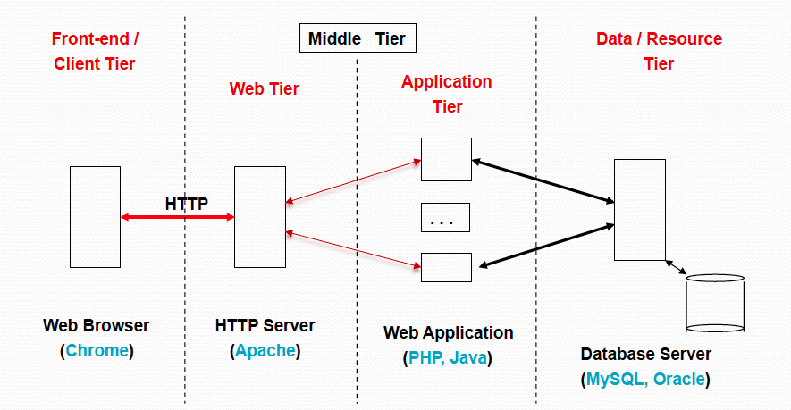
Where does DB fit in Web Architecture?

Slide 21
MYSQL
MySQL is probably the most popular DBMS for web servers
Powerful
Fast
Scalable
Free
Three main ways you can interact with MySQL
Using a command line
Via a web interface such as phpMyAdmin
Through a programming language like Java, PHP, etc.

Slide 22
MySQL – Via Command Line
Assuming that XAMPP / MAMP is installed, the web server is running, and MySQL server has started …
You will be able to access the MySQL executable from the MySQL installation directory:
/Applications/XAMPP/bin
By default, the initial MySQL user is root and it will have a password of root too. So, to start a mySQL client, the following on a Terminal
/Applications/XAMPP/bin/mysql --host=localhost -uroot –proot
You have just logged into MySQL as user root
Now you are ready to type in sql commands

Slide 23
MySQL – Via Command Line
Start MAMP / XAMPP
Start the server
Open MySQL shell:
Unix / Mac:
/Applications/MAMP/Library/bin/mysql --host=localhost -uroot –proot
Windows:
cd c:\xampp\mysql\bin
mysql.exe -u root --password
Either type statements directly, or run mydb.sql
source mydb.sql

Slide 24
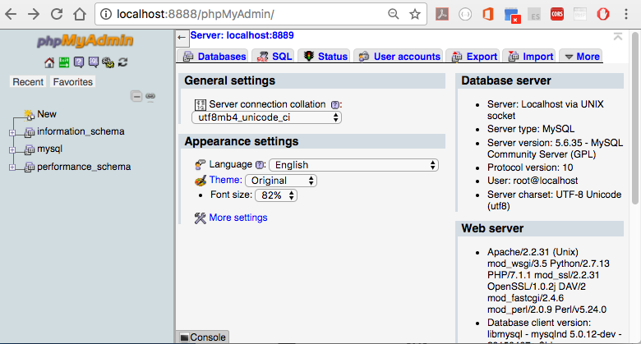
MySQL – via phpMyAdmin
Once you start XAMMP/ MAMP server, go to phpMyAdmin by going to http://localhost:8888/phpMyAdmin/

Slide 25
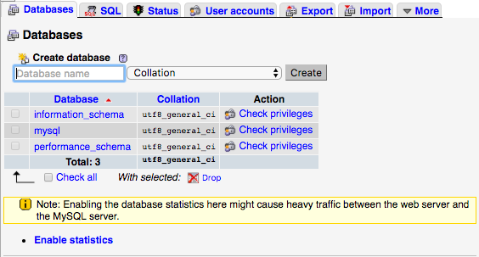
MySQL – via phpMyAdmin
Creating a database
Click on ‘databases’ tab
Enter ‘database’ name and then press ‘create’

Slide 26
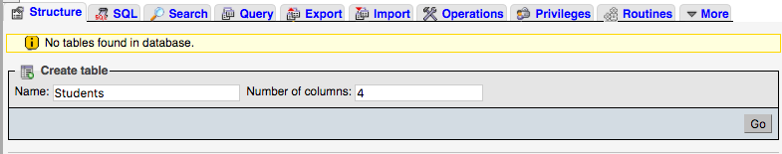
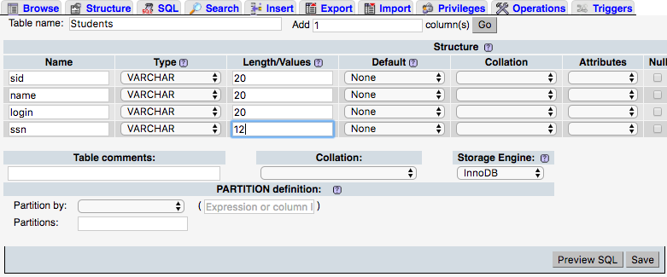
MySQL – via phpMyAdmin
Table name
Creating a table

Slide 27
MySQL – Via PHP
Using PHP APIs and MySQL:
Connect to the database
Handle connection errors
Execute the SQL query
Process the results
Free resources and close connection
Our program needs to setup a connection to the database.
This can be accomplished using procedural mysqli and PHD Data Objects (PDO).

Slide 28
Bookstore DB
Customer
Book
* custid: int
name: varchar (256)
phone: varchar (64)
* isbn : int
title : varchar (256)
author varchar (256)
price : double
category varchar(20)
year: char(4)
1
Book
1
* custid: int
* isbn : int
quantity: int
n
n

Slide 29
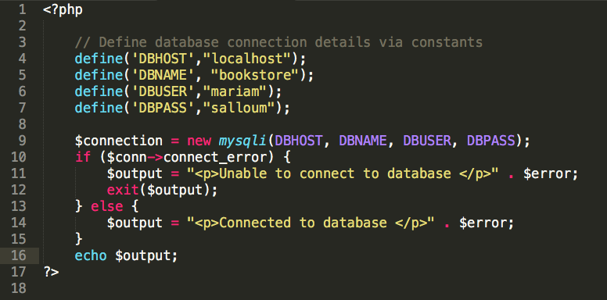

Slide 30
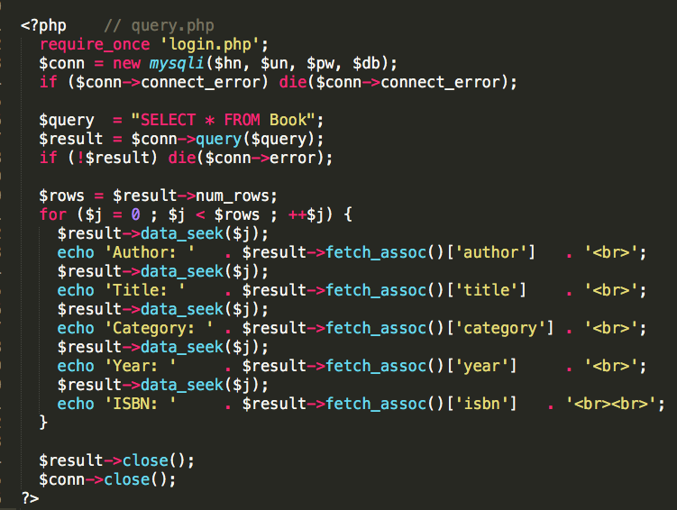
Connect to mySQL and select the database to use
Build a query string and run
Retrieve the results and output them to a web page
Repeat steps 2 to 4 until all desired data has been retrieved
Disconnect from MySQL

